Slide 1

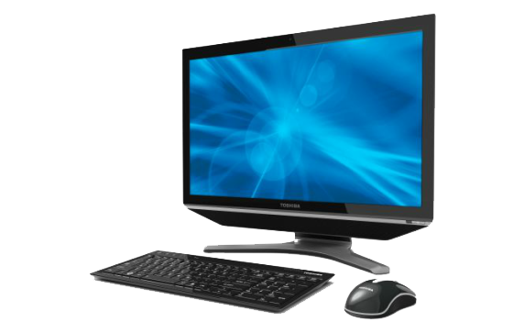
PANIMALAR INSTITUTE OF TECHNOLOGY
Jaisakthi Educational Trust
(A Christian Minority Institution)
391, Bangalore Trunk Road, Varadharajapuram, Poonamallee, Chennai, Tamil Nadu 600123.
Department of Computer Science and Engineering
Mini Project on
VIRTUAL MOUSE USING PYTHON
Batch-1
Project Guide:
Team Members:
Mrs. A. Jerrin Simla , M.E. , (Ph.D)
Associate Professor,
Computer Science of Engineering.
Gudluru Lakshmi Narayana
2019PITCS198
211519104048
Nirmal Kumar K
2019PITCS233
211519104097
Prabhakaran K
2019PITCS241
211519104115

Slide 2
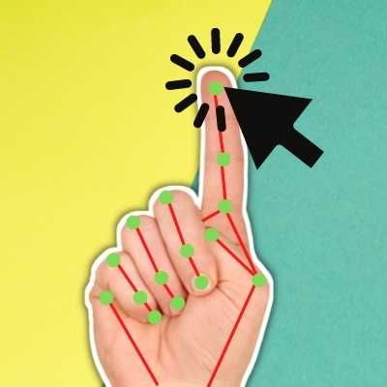
Introduction
There is no other more popular navigation/interaction device than the mouse.
Overcoming the restrictions a corporeal device has would enrich the experience of interaction.
Keeping this in mind, we present an idea of implementing a virtual mouse system as an alternative.

Slide 3
Abstract
With new changes seen in computer technology day by day, it has become quite essential for us to find specific new ways of interaction with computer systems as its need is increasing in society every day. Today, every device is making the use of touch screen technology on its systems, which isn't affordable to be used in all applications. A specific interactive module like a virtual mouse that makes use of Object Tracking and Gestures that will help us to interact can be an alternative way for the traditional touch screen and the physical mouse.

Slide 4
Objective
The main objective of the AI virtual mouse system is to control the mouse cursor functions by using the hand gestures instead of using a physical mouse
The goal is to manage computers and other devices with gestures rather
The proposed AI virtual mouse system is to develop an alternative to the regular and traditional mouse system to perform and control the mouse functions, and this can be achieved with the help of a web camera that captures the hand gestures and hand tip and then processes these frames to perform the particular mouse function such as left click, right click, and scrolling function.

Slide 5
Hardware And Software Required
Hardware Requirements -
Intel Pentium D processor 1.8 GHz or AMD Athlon X2 processor 1.8 GHz or higher
3 GB RAM
5 GB HDD space
Peripheral webcam at least 30 frames/second, 640x480 resolution
Software Requirements -
Windows XP x86 or higher (for x86 environment)
Windows XP professional x64 or higher (for x64 environment)
.NET framework 3.5 or higher
Visual Studio 2008 professional
EmguCV library (wrapper of OpenCV library for .NET framework
EmguCV library 64 bit binaries (for developing on x64 environment)
Webcam drivers (device specific)

Slide 6
Proposed System
Any new products should either make human life more confortable, more productive or more fun.
Provides gather flexibility than the existing system.
Can provide more functions depending on the choice of object.
Easy to modify and adapt
Less prone to physical damage due to absence of a fixed Physical device.
Avoid the mouse-related wrist damage like CTS & RSI.
Also, there is a certain degree of fun & entertainment associated with the whole idea.

Slide 7
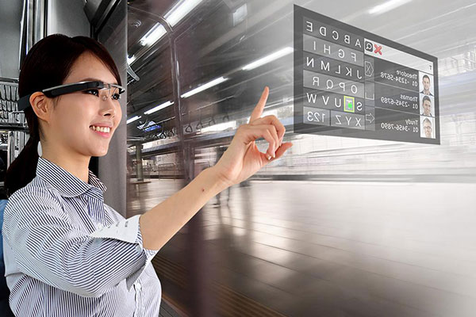
Feature Enhancement :
Development for specific objects.
Creation of particular action areas for utility.
More advanced and highly specific functionality.

Slide 8
LITERATURE REVIEW
REVIEW 1:
TITLE: Comparing and Combining Virtual Hand and Virtual Ray Pointer Interactions for Data Manipulation in Immersive Analytics
AUTHORS NAME : Jorge Wagner , Wolfgang Stuerzlinger , Luciana Nedel
PUBLISHED ON : 2021 MAY.
METHOD USED : 3D Space-Time Cube , Virtual Desk.
EXISTING TECHNOLOGY : It detects the virtual ray pointers using a hand watch which is a hardware used on the hand.
ADVANTAGE : Captures and interprets the data.
FUTURE SCOPE : Virtual Smart Watches.

Slide 9
REVIEW 2:
TITLE: Shuttle Space: Exploring and Analyzing Movement Trajectory inImmersive Visualization
AUTHORS NAME : Shuainan Ye, Zhutian Chen, Xiangtong Chu, Yifan Wang, Siwei Fu, Lejun Shen, Kun Zhou, and
Yingcai Wu
PUBLISHED ON : 2021 February.
METHOD USED : 3D and 2D Technologies.
EXISTING TECHNOLOGY : It detects the virtual pointers of the sports person
ADVANTAGE : Captures and interprets the data of a sports person.
FUTURE SCOPE : Virtual Reality.

Slide 10
REVIEW 3:
TITLE: I-Keyboard: Fully Imaginary Keyboard on Touch Devices Empowered by Deep Neural Decoder
AUTHORS NAME : Ue-Hwan Kim , Sahng-Min Yoo , and Jong-Hwan Kim.
PUBLISHED ON : 2021 September.
METHOD USED : 3D and 2D Technologies.
EXISTING TECHNOLOGY : It texts the data with the help of virtual elevations.
ADVANTAGE : Captures and interprets the data of the keys.
FUTURE SCOPE : Virtual Keyboad using camara.

Slide 11
MODULES
Dataset Loading:
dataset module is used to open Dataset classes and other subclasses and open virtual are used.
Training:
In this module the images are trained according to our requirement using camara attached to the system.
Load Model:
Here we load Open CV and Mediapipe model to detect the images or objects from the video using frames.

Slide 12
Read Frame:
In here, we read the images which are detected by camera using Open CV and Mediapipe.
Pre process frame:
Frame objects are here processed according to the chosen set of parameters.

Slide 13
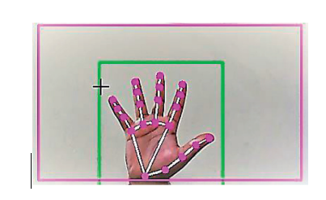
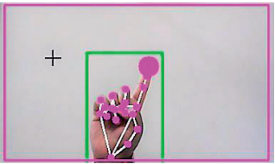
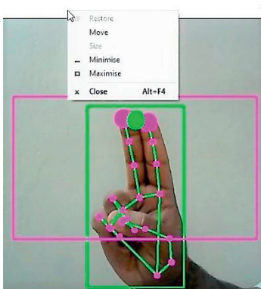
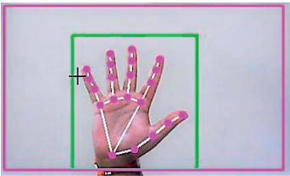
SCREENSHOTS
Capturing video using the webcam (computer vision).
Detection of which finger is up.
Gesture for the computer to perform no action.
Gesture for the computer to perform right button click.

Slide 14
Architectural Diagram
Image
Acquisition
Object
Recognition
Track Object
Event
Generation
Setting Cursor
Position
Coordinate
Calculation

Slide 15
Conclusion
Virtual Mouse is an idea of implementing an adaptable, multi- functional navigation/interaction tool that overcomes physical barriers.

Slide 16
References
Artificial Intelligence – A Modern Approach (3rd Edition) – By Stuart Russell & Peter Norvig
Machine Learning for Dummies – By John Paul Mueller and Luca Massaron
Machine Learning: The New AI – By Ethem Alpaydin
The Hundred-Page Machine Learning Book – By Andriy Burkov
Artificial Intelligence for Humans – By Jeff Heaton
Building Virtual Machine Labs A Hands-On Guide - Mr. Tony V Robinson
Oracle VirtualBox Administration A beginners guide to virtualization! - Arun Kumar

Slide 17
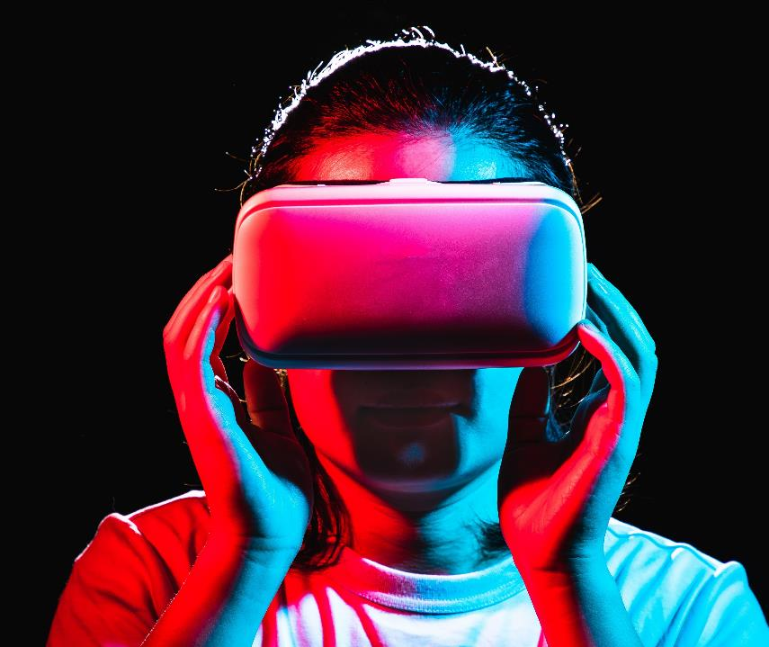
Thank you For Giving Me This Opportunity

